Slide 1

Programming in Java
Topic: Interfaces & Lambda Expressions

Slide 2
Contents
Interface
Functional Interface
Introduction of Lambda Expressions

Slide 3
Interface
An interface in java is a blueprint of a class. It has static constants and abstract methods.
The interface in java is a mechanism to achieve abstraction. There can be only abstract methods in the java interface not method body. It is used to achieve abstraction and multiple inheritance in Java.
Java Interface also represents IS-A relationship.

Slide 4
Interface
An interface is a reference type, similar to a class, that can contain only constants, method signatures, default methods, static methods, and nested types.
Method bodies exist only for default methods and static methods.
Interfaces cannot be instantiated, they can only be implemented by classes or extended by other interfaces.

Slide 5
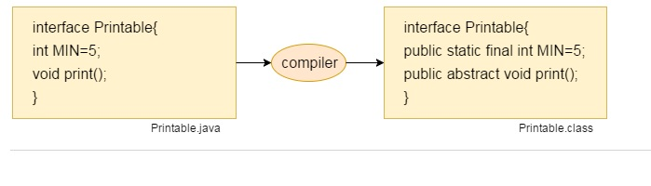
Interface fields are public, static and final by default, and methods are public and abstract by default.

Slide 6
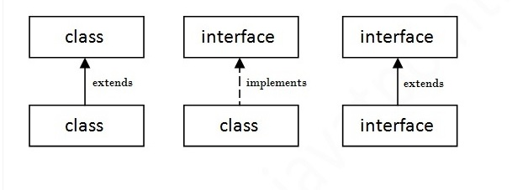
Relationship between Classes and Interfaces
As shown in the figure given below
A class extends another class,
An interface extends another interface
But a class implements an interface.

Slide 7
interface printable
{
void print();
}
class A implements printable
{
public void print(){System.out.println("Hello");}
public static void main(String args[])
{
A obj = new A();
obj.print();
}
}
Notes:
TestInterface2.java

Slide 8
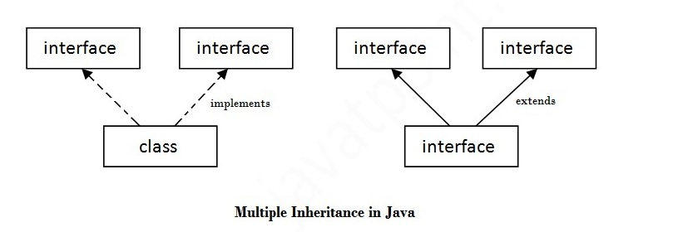
Multiple Inheritance in Java by Interface
If a class implements multiple interfaces, or an interface extends multiple interfaces i.e. known as multiple inheritance.

Slide 9
interface Printable
{
void print();
}
interface Showable
{
void print();
}
class TestInterface3 implements Printable, Showable
{
public void print(){System.out.println("Hello");}
public static void main(String args[])
{
TestInterface3 obj = new TestInterface3();
obj.print();
}
}

Slide 10
In previous program,Printable and Showable interface have same methods but its implementation is provided by class TestTnterface1, so there is no ambiguity.

Slide 11
Interface Inheritance
A class implements interface but one interface extends another interface .
interface Printable
{
void print();
}
interface Showable extends Printable
{
void show();
}
class TestInterface4 implements Showable
{
public void print(){System.out.println("Hello");}
public void show(){System.out.println("Welcome");}
public static void main(String args[]){
TestInterface4 obj = new TestInterface4();
obj.print();
obj.show(); } }

Slide 12
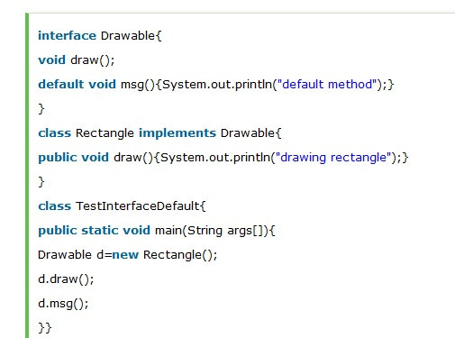
Java 8 Default Method in Interface
Since Java 8, we can have method body in interface.
But we need to make it default method.

Slide 13
Default Methods
Default Method allows to add new methods to the interfaces without breaking the existing implementation of an interface.
It provides flexibility to allow interface define implementation which will be used as default in the situation where a concrete class fails to provide an implementation for that method.
It can be overridden or made abstract in the inherited class or interface.

Slide 14
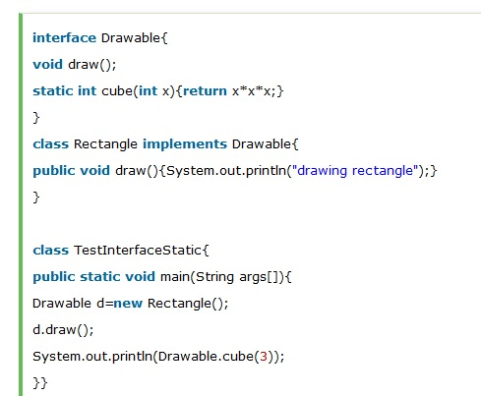
Java 8 Static Method in Interface
Since Java 8, we can have static method in interface.

Slide 15
Difference between abstract class and interface
Abstract class and interface both are used to achieve abstraction where we can declare the abstract methods.
Abstract class and interface both can't be instantiated.

Slide 16
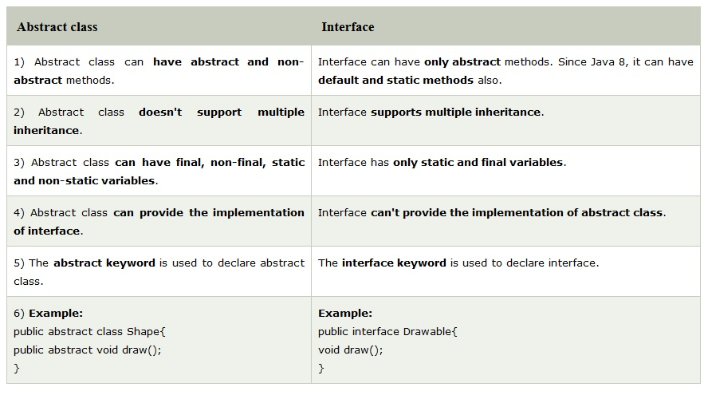

Slide 17
Java Functional Interfaces
An Interface that contains exactly one abstract method is known as functional interface.
It can have any number of default, static methods but can contain only one abstract method.
It can also declare methods of object class.
Functional Interface is also known as Single Abstract Method Interfaces or SAM Interfaces.
It is a new feature in Java, which helps to achieve functional programming approach.

Slide 18
@FunctionalInterface
interface Printable
{
void say(String msg); //abstract method
}
public class A implements Printable
{
public void say(String msg)
{
System.out.println(msg);
}
public static void main(String[] args)
{
A a = new A();
a.say("Hello there");
}
}

Slide 19
Invalid Functional Interface:
A functional interface can extends another interface only when it does not have any abstract method.

Slide 20
Lambda Expressions
Lambda expression is a new and important feature of Java which was included in Java SE 8.
The Lambda expression is used to provide the implementation of an interface which has functional interface.
It saves a lot of code.
In case of lambda expression, we don't need to define the method again for providing the implementation. Here, we just write the implementation code.
Java lambda expression is treated as a function, so compiler does not create .class file.

Slide 21
Why use Lambda Expression
To provide the implementation of Functional interface.
Less coding.

Slide 22
Java Lambda Expression Syntax
(argument-list) -> {body}
Java lambda expression consists of three components:
1) Argument-list: It can be empty or non-empty as well.
2) Arrow-token: It is used to link arguments-list and body of expression.
3) Body: It contains expressions and statements for lambda expression.

Slide 23
Example: Without Lambda Expression
interface Drawable
{ public void draw(); }
public class LambdaExpressionExample
{
public static void main(String[] args)
{
int width=10;
//without lambda, Drawable implementation using anonymous class Drawable d=new Drawable()
{
public void draw(){System.out.println("Drawing "+width);}
};
d.draw();
}
}

Slide 24
Java Lambda Expression Example
interface Drawable
{ public void draw(); }
public class LambdaExpressionExample2
{
public static void main(String[] args)
{
int width=10;
//with lambda
Drawable d2=()->
{ System.out.println("Drawing "+width); };
d2.draw();
}
}

Slide 25
Java Lambda Expression Example: No Parameter
interface Sayable
{
public String say();
}
public class LambdaExpressionExample3
{
public static void main(String[] args)
{
Sayable s=()->
{
return ”Java Programming";
};
System.out.println(s.say());
}
}

Slide 26
Java Lambda Expression Example: Single Parameter
interface Sayable
{ public String say(String name); }
public class LambdaExpressionExample4{
public static void main(String[] args) {
// Lambda expression with single parameter.
Sayable s1=(name)->{
return "Hello, "+name; };
System.out.println(s1.say(“Java"));
// You can omit function parentheses
Sayable s2= name ->
{
return "Hello, "+name;
};
System.out.println(s2.say(“Programming"));
}
}

Slide 27
Java Lambda Expression Example: Multiple Parameters
interface Addable
{ int add(int a,int b); }
public class LambdaExpressionExample5
{
public static void main(String[] args)
{
// Multiple parameters in lambda expression
Addable ad1=(a,b)->(a+b);
System.out.println(ad1.add(10,20));
// Multiple parameters with data type in lambda expression
Addable ad2=(int a,int b)->(a+b);
System.out.println(ad2.add(100,200));
}
}

Slide 28
Java Lambda Expression Example: with or without return keyword
interface Addable
{ int add(int a,int b); }
public class LambdaExpressionExample6
{
public static void main(String[] args)
{
// Lambda expression without return keyword.
Addable ad1=(a,b)->(a+b);
System.out.println(ad1.add(10,20));
// Lambda expression with return keyword.
Addable ad2=(int a,int b)->
{
return (a+b);
};
System.out.println(ad2.add(100,200));
}
}

Slide 29


